Slide 1
Frontiers in Biology Seminar Series
CNV Detection Pipeline for the NeoHEME NGS Assay
Continuing Education Opportunity:
1 contact hour in Molecular Pathology, NeoUniversity course
Course: #20-891601
Agenda:
9:00-9:10A PT, Dr. Fernando Lopez-Diaz, Principal Scientist, R&D
Introduction
9:10-9:40A PT, Dr. Christophe Magnan, Senior Bioinformatics Scientist, R&D CNV Detection Pipeline for the NeoHEME NGS Assay
9:40-10:00A PT, Q&A and Panel Discussion
Collaborating Departments & Hosts:
Research & Development
Medical Affairs

Slide 2
The Scientific Collaboration and Engagement team fosters education that enrichens the global scientific and medical community’s understanding of cancer diagnostics to point the way toward advancing patient care
Notes:
For this slide, maybe there’s some way to make the text more emphasized?

Slide 3

Join the NeoGenomics Molecular Tumor Boards
Multidisciplinary teams have live discussions consulting on multiple cases with expert oncologists
Physicians can submit cases for discussion
Lung, breast, colorectal, and more
For more information, visit neogenomics.com/client-services/education/tumor-boards

Slide 4
CNV Detection Pipeline for the NeoHEME NGS Assay
Frontiers in Biology Series – February 2022
Dr. Christophe Magnan, PhD
Senior Bioinformatics Scientist, R&D

Slide 5
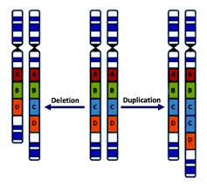
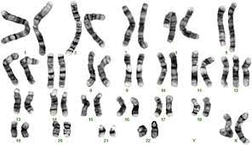
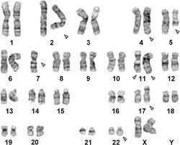
Copy Number Variations (CNV)
Monosomy 7
Loss
Gain
Trisomy 12
Large regions (e.g. chromosome, arm)
Small regions (e.g. cytoband, gene, exon)
Number of copies from 0 to ~20?
2 copies = normal karyotype
Less than 2 copies = loss/deletion
More than 2 = gain/duplication/amplification

Slide 6
Copy Number Variations (CNV)
Not specific to cancers
Down syndrome (Trisomy 21)
Turner syndrome (Monosomy X)
Not necessarily associated to a disease
Role, effect, and extent of CNVs not fully understood
Prominent features of hematologic and solid cancers
Commonly observed in most cancers
Some CNV are characteristic of specific types of cancer
Monosomy 7 in MDS/AML
Trisomy 12 in CLL
Involved in development and progression of cancer
Alters the normal gene expression levels
Detection useful for prognosis and treatment

Slide 7
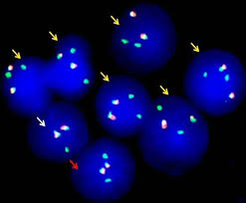
Some CNV Detection Methods…
FISH
Pros: medium resolution, quantitative and structural abnormalities, single cell view, sensitivity, well established
Cons: localized, number of observed cells still relatively low
NGS
Pros: whole genome or targeted, high resolution, quantitative and structural abnormalities, very high number of sequenced cells
Cons: heavily relies on coverage uniformity, noisy data, limits of detection, bulk sequencing, methods not particularly well established
Cytogenetics
Pros: whole genome, quantitative and structural abnormalities, individual cell view, well established
Cons: resolution, low number of observed cells results in a lower sensitivity overall

Slide 8
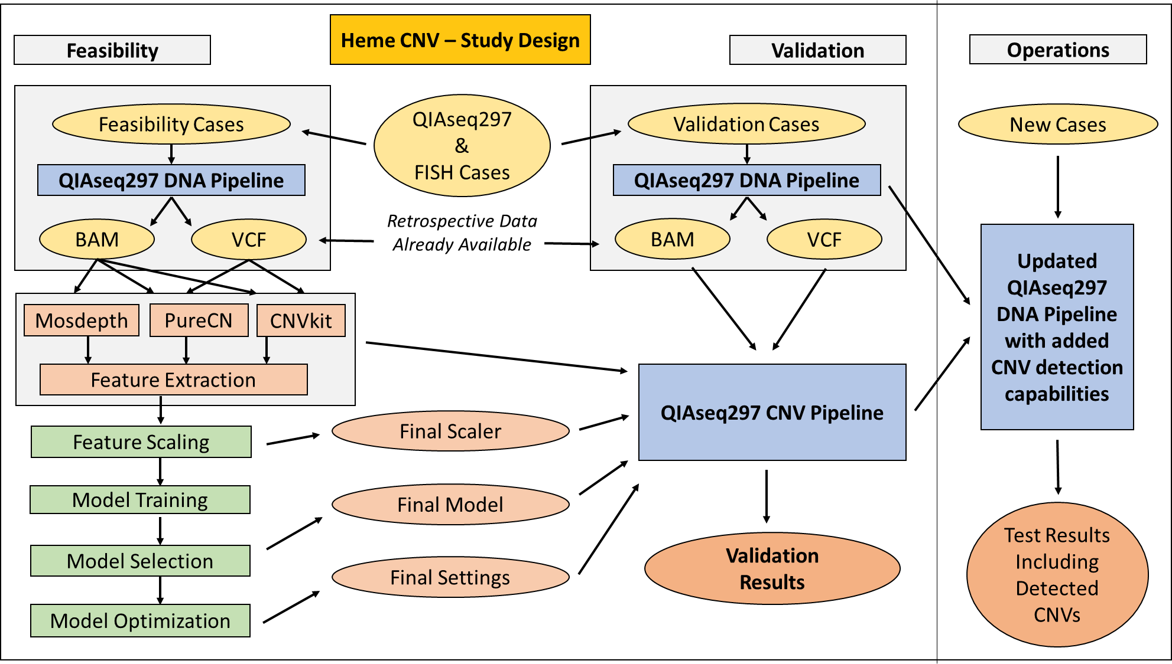
Project Overview

Slide 9
Step 1 – Data Collection

Slide 10
Data Collection
Extracted Metadata Mapping, Merging,
And Filtering
FISH Reports
387,938 Total
FISH Results
Extraction
NGS Reports
113,456 Total
NGS Sample Metadata Extraction
Heme CNV Data
9,015 Concurrent Cases
364,210 Genes With CNV Information
From FISH
Isilon
257,951 BAM
176,547 VCF
NGS Data + Quality Controls

Slide 11
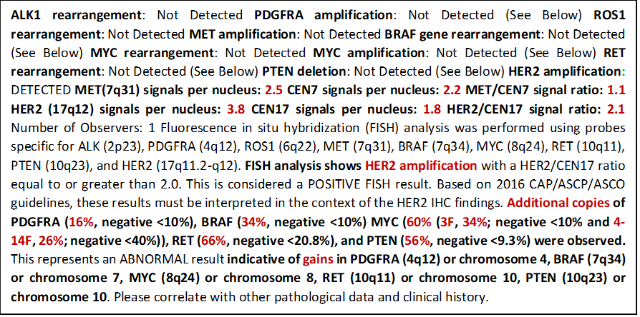
Automated Fish Results Extraction
Over a thousand text patterns recognized
Gain/loss result for each marker automatically extracted
Percentage of abnormal cells automatically extracted
Parsing error rate found at 0.7% on validation samples

Slide 12
FISH & NGS Panels
 | Feasibility Dataset | Validation Dataset
AML Favorable Risk | 272 | 107
AML Non-Favorable Risk | 221 | 89
AML Standard | 1,014 | 448
CLL | 990 | 72
MDS Extended | 1,642 | 700
MDS Standard | 1,081 | 505
NeoTYPE™ CLL Prognostic FISH Panel | 692 | 659
Plasma Cell Myeloma Panel | 217 | 90
Plasma Cell Myeloma Prognostic Panel | 139 | 60
 | Feasibility Dataset | Validation Dataset
NeoTYPE™ AML Prognostic Profile | 692 | 269
NeoTYPE™ CLL Prognostic Profile | 1,604 | 701
NeoTYPE™ Lymphoma Profile | 48 | 16
NeoTYPE™ MDS/CMML Profile | 1,185 | 431
NeoTYPE™ Myeloid Disorders Profile | 2,391 | 1,183

Slide 13
62 Genes With CNV Result From FISH
APC | CCND2 | CUX1 | ETV6 | KMT2A | MET | PDGFRB | RAD21 | SMO
ARID2 | CDC25C | DDX41 | EZH2 | KMT2C | MYC | PIK3R1 | RHEB | STAT6
ATM | CDK2 | EBF1 | FGFR1 | KMT2D | NBN | PMS2 | RPS26 | TERT
ATP2A2 | CDK4 | EGFR | GNA12 | KRAS | NF1 | POT1 | SAMD9 | TP53
BRAF | CDK6 | EGR1 | IKBKB | LUC7L2 | NHP2 | PRPF40B | SAMD9L | UBR5
CARD11 | CDKN1B | ERBB3 | IKZF1 | MAP3K1 | NPM1 | PTPN11 | SBDS | ZFHX4
CBFB | CSF1R | ETNK1 | IRAK4 | MDM2 | NSD1 | RAC1 | SH2B3 | -
8 genes annotated using a direct FISH marker (gene covered by the FISH probe)
54 genes annotated using an indirect FISH marker (e.g. centromeric probes)
Total of 364,210 instances of a gene annotated from a FISH result (detail below)
 | Feasibility Dataset | Validation Dataset
Genes with CNV information from FISH | 252,858 | 111,352
Genes with a normal result from FISH | 229,149 | 101,289
Genes with a loss result from FISH | 14,898 | 6,090
Genes with a gain result from FISH | 8,811 | 3,973

Slide 14
Step 2 – Pipeline Development

Slide 15
Features for each gene in each sample (20)
QIAseq297
Pipeline
VCF
BAM
← Retrospective Data
PureCN
CNVkit
Mosdepth
← Third-Party Tools
32 genes out of 302 in the panel excluded due to these features
270 genes covered by the CNV methods
Segment-Level Log₂(CN) x 4
Gene-Level Log₂(CN) x 6
Normalized Coverage 1
Normalized Coverage 10
…
Predictions From Existing Tools
PureCN and CNVkit selected
Baseline accuracy: 95% to 96%
Predicted Log₂(CN) used as found
Gene and segment level results
Confidence intervals included
Expected > 0 for gain and < 0 for loss
Normalized Coverages
Classic and experimental features
11K samples to assess assay-specific coverage variations and biases
Comparison between gene coverage and other elements / expected normal
Expected > 1 for gain and < 1 for loss

Slide 16
Examples of extracted features
All 20 features show a good correlation to FISH result
Signal is clear for these selected examples but not always the case
How to make a single decision automatically from these features?
Too many possible gain/loss cutoffs and decision rules
Solution: Machine Learning (ideal for these situations)

Slide 17
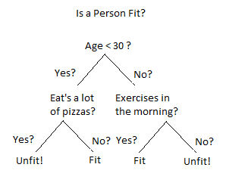

Random Forest Classifier
Gene with unknown CNV information
252,858 genes with known CNV information
Features +
Random Forest
Training Algorithm
Features
CNV Result
Random Forest CNV Model
CNV Result
CNV Prediction
Loss: 71.23%
Gain: 03.56%
Normal: 25.21%

Slide 18
Random Forest Classifier
Gene with unknown CNV information
252,858 genes with known CNV information
Features +
Random Forest
Training Algorithm
Features
CNV Result
Random Forest CNV Model
Final CNV Prediction
Class with the highest probability is predicted
Class probability is a measure of confidence
Minimal confidence level required for each gene
Method to establish cutoffs not detailed here
Final outputs of the pipeline:
Predicted CNV class (loss, normal, gain)
Rescaled prediction score / confidence level
CNV Result
CNV Prediction
Loss: 71.23%
Gain: 03.56%
Normal: 25.21%

Slide 19
Step 3 – Pipeline Validation

Slide 20
Pipeline Validation Results (1)
Model evaluated on each of the 62 genes
111,352 individual tests performed (1 gene x 1 sample)
Baseline accuracy (CNVkit, PureCN): 95% to 96%
Validation results summary:
Performance Characteristics | Percentage
Accuracy | 98.17%
Sensitivity | 95.98%
Specificity | 98.36%

Slide 21
Pipeline Validation Results (2)
Highest concordance when comparing NGS and FISH at the exact same location
Gene | Direction | Positive Cases |  |  | Negative Cases |  |  | All Cases
 |  | Total | Conc. | Sensitivity | Total | Conc. | Specificity | Total | Conc. | Accuracy
ATM | loss | 72 | 72 | 100.00% | 641 | 629 | 98.13% | 713 | 701 | 98.32%
CBFB | loss | 23 | 22 | 95.65% | 517 | 506 | 97.87% | 540 | 528 | 97.78%
EGR1 | loss | 171 | 169 | 98.83% | 1,541 | 1,538 | 99.81% | 1,712 | 1,707 | 99.71%
KMT2A | gain | 27 | 25 | 92.59% | 474 | 472 | 99.58% | 501 | 497 | 99.20%
MET | loss | 113 | 113 | 100.00% | 1,593 | 1,582 | 99.31% | 1,706 | 1,695 | 99.36%
NF1 | loss | 15 | 15 | 100.00% | 908 | 908 | 100.00% | 923 | 923 | 100.00%
TERT | loss | 10 | 10 | 100.00% | 1,723 | 1,709 | 99.19% | 1,733 | 1,719 | 99.19%
TP53 | loss | 76 | 73 | 96.05% | 1,567 | 1,556 | 99.30% | 1,643 | 1,629 | 99.15%

Slide 22
CNV Pipeline Validation Summary
Ensemble approach provides between 2% and 3% improvement
Limit of detection: 20% abnormal cells / tumor content
No limitation on the number of copies above the LOD
Homozygous/heterozygous deletions both detected
Gains detected with as low as 3 copies of the gene
No matched normal sample required
270 QIAseq297 genes covered by the methods
3 genes included in the recently launched ALL panel

Slide 23
Q&A
Thank you!
Hyunjun Nam
Rudy Fabunan
Segun Jung
Vincent Funari
Fernando Lopez-Diaz
Chaugiang Duong

